Slide 1
Pionairs - AGM
Linda De Quintal – Director, Global Benefits
Montreal, May 1, 2025

Slide 2
Agenda
  Transition period
  Plan experience
    Claim Secure – January 1, 2023, to March 31, 2024
    Manulife – April 1, 2024, to December 31, 2024
  Frequently Asked Questions (FAQ’s)

Slide 3
Claim Secure
Plan Experience
January 1, 2023, to March 31, 2024

Slide 4
Claim Secure
  Claims incurred between January 1, 2024, to March 31, 2024 (Q1), administered by ClaimSecure
    Deadline to submit claims incurred from January 1, 2023, to March 31, 2024, was May 31, 2024 (Runoff Period)
Expenditures
Health | $10,516,761
Drugs | $28,508,521
Dental | $16,435,488
Runoff period | $2,175,384
Total | $57,636,154
  Claims incurred on or after April 1, 2024, administered by Manulife

Slide 5
Manulife
Plan Experience
April 1, 2024, to December 31, 2024

Slide 6

Manulife – Expenditures - Health
Total cost: $27,546,058.15
Claimant information |  |  | Payment information -Health
Participants | Number of participants |  | Payment type
Retirees | 25883 |  | Point of Service | 79% of claims
Spouse | 13111 |  | Paper submission | 14 % of claims
Dependent | 749 |  | Online submission | 7% of claims
Total | 39743
Notes:
Other:
Medical Services (routine check-ups, preventive care, eye exams etc.) . Supplies (wheelchairs, hospital beds, blood pressure monitor etc)
88% of dental claims pertain to basic dental services such as cleaning and scaling, while the remaining claims are distributed among endodontics, periodontics, major dental procedures, dentures, and orthodontics.
Other: Endotics,Periodontics & Dentures: $480,134 (4.5%)

Slide 7

Manulife – Expenditures - Dental
Total cost: $9,918,733.07
Number of participants 19989 |  | Payment information -Health
 |  | Payment type
 |  | Point of Service | 87% of claims
 |  | Paper submission | 11% of claims
 |  | Online submission | 2% of claims
Notes:
Other:
Medical Services (routine check-ups, preventive care, eye exams etc.) . Supplies (wheelchairs, hospital beds, blood pressure monitor etc)
88% of dental claims pertain to basic dental services such as cleaning and scaling, while the remaining claims are distributed among endodontics, periodontics, major dental procedures, dentures, and orthodontics.
Other: Endotics,Periodontics & Dentures: $480,134 (4.5%)
Major: Includes Dentures

Slide 8
Manulife – Expenditures - Health, Drugs & Dental
Total cost: $37,464,791.22
Dental: $9,918,733.07
Paramedical: $4,516,025.73
Other: $2,824,035.15
Notes:
Other:
Medical Services (routine check-ups, preventive care, eye exams etc.) . Supplies (wheelchairs, hospital beds, blood pressure monitor etc)
88% of dental claims pertain to basic dental services such as cleaning and scaling, while the remaining claims are distributed among endodontics, periodontics, major dental procedures, dentures, and orthodontics.
Other: Endotics,Periodontics & Dentures: $480,134 (4.5%)

Slide 9
Manulife – Prescription Drugs
Here is the updated bar graph with labels added to each bar:
Notes:
Diabetes: Ozempic / Freestyle HBP: Crestor

Slide 10
Prescription Drug Program
Manulife – Manage Care Journey
Right use
Step Therapy Program
Seamless pharmacy experience
Considers prior medication
DrugWatch Program
Monitors new medications on the market
Right Drug
Right Time
Specialty Drug Care Program
Voluntary program supporting employees with chronic illness
Prior Authorization Program

Slide 11
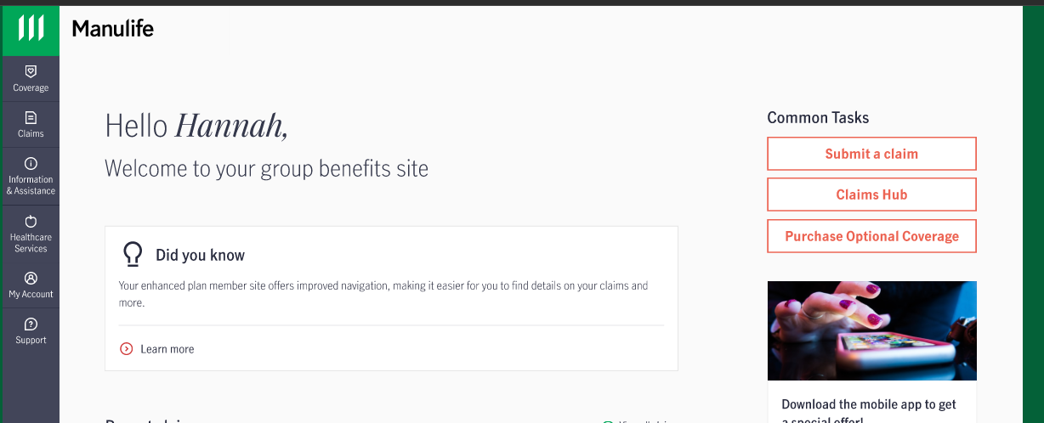
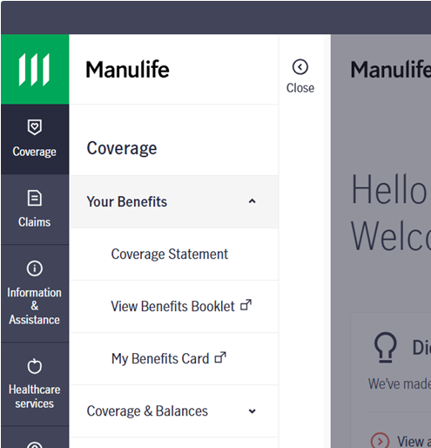
Manulife – Life Insurance
Basic Group Life
•Company paid
•Number of paid claims: 500
1. Employee Optional Life
Previously called Supplementary Life Insurance
•Termination age 70
•Maximum coverage amount: $50,000
•Number of paid claims: 8
2. Spouse Optional Life
Previously called Supplementary Dependent Life Insurance
•Termination age 70 (based on retiree age)
•Maximum coverage amount: $35,000
•Number of paid claims: 1
3. Voluntary Accidental Death & Dismemberment
Employee Paid
Termination age : None
Note: New applications for #1 & 2 subject to Evidence of Insurability (EOI)
$1.2M
Visit your Manulife Plan Member site to view or apply for optional coverage

Slide 12
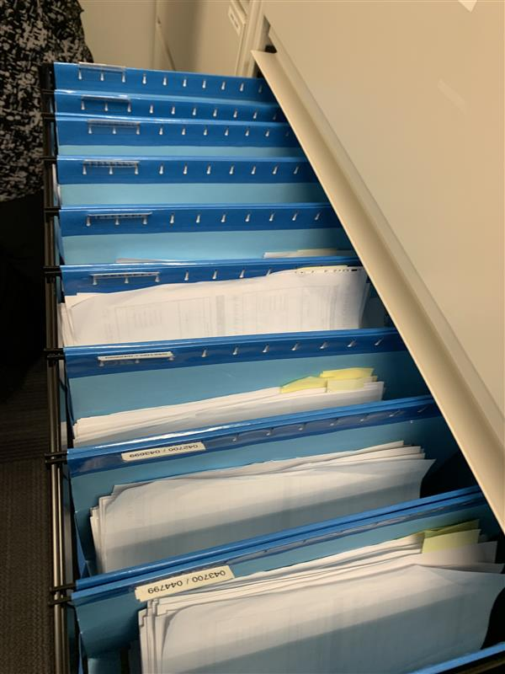
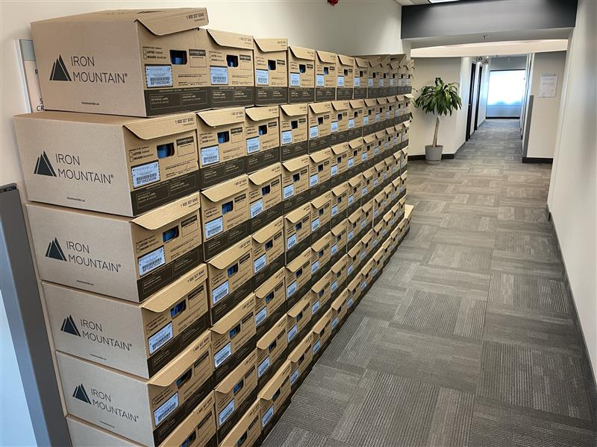
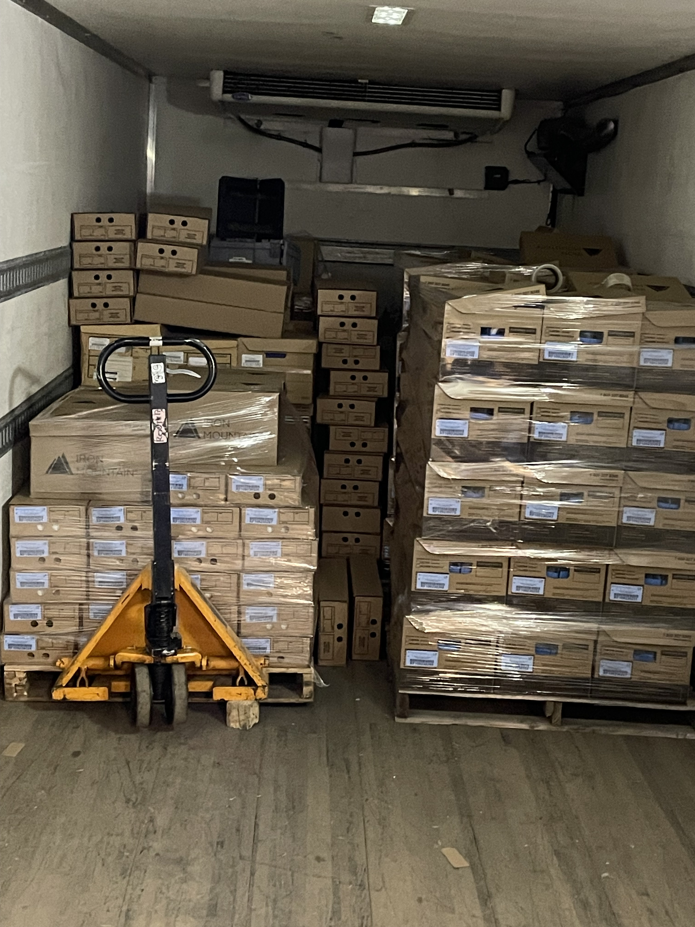
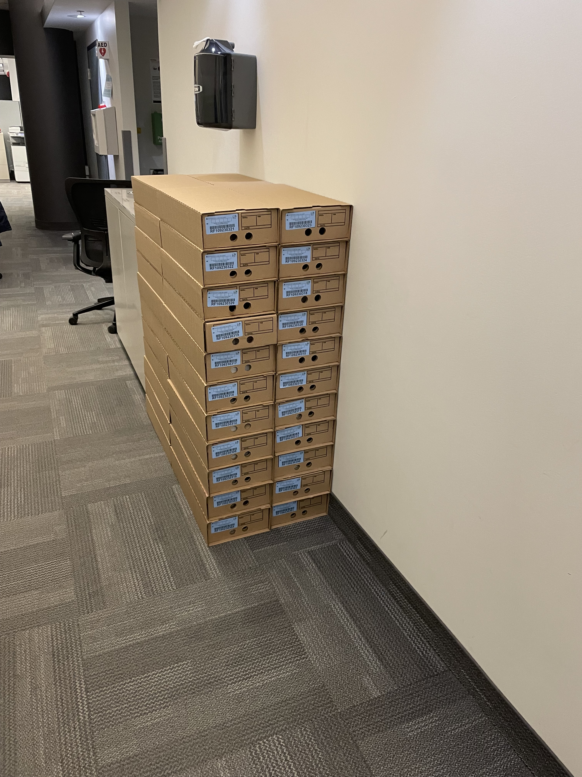
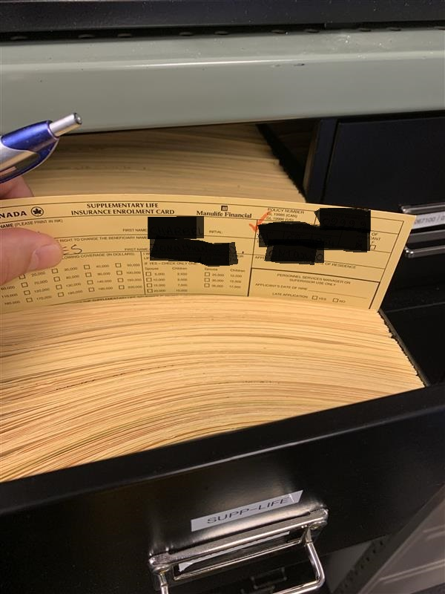
Beneficiary Designation in Pics
Notes:
CC Canada – YUL/YHZ

Slide 13
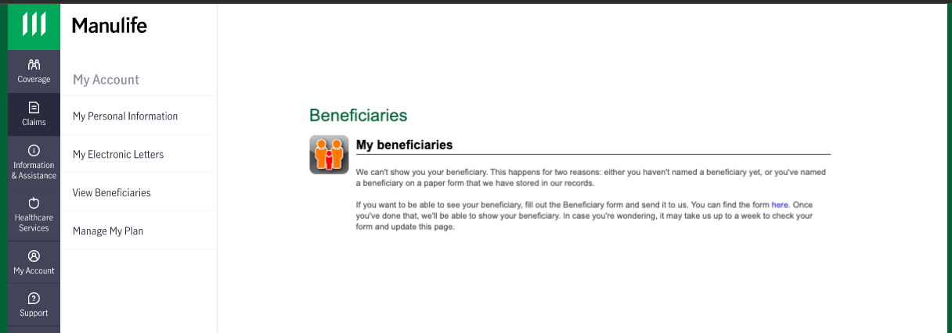
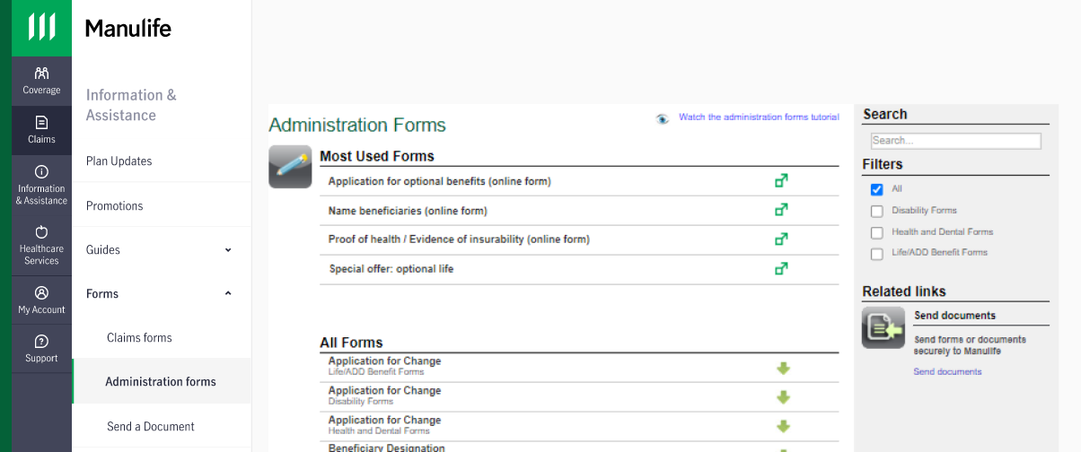
Beneficiary Designation
2)
How to report the passing of a loved one
Contact HR Connex at 1-833-847-3675 and Select Option #5
Manulife will handle life insurance proceedings and/or survivor set up, if applicable
Process for Survivor set-up:
  First 3 months following date of passing;date coverage extended under retiree AC ID
  Extension transitioned under Survivor ID number
Notes:
Canadian CC YUL YHZ

Slide 14
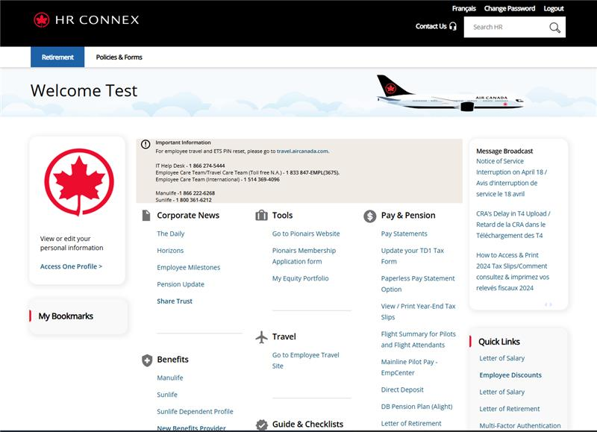
Reminder
Maintain your personal information up to date with Air Canada
You can update online your:
Email address
Home address
Banking information (direct deposit of pension payment Vs check)
Much more !!!
Notes:
Add tax slip update – Canada Poste
Banking information update

Slide 15


Manulife – Call and Claims volume
April 1, 2024, to December 31, 2024
RETIREES
Members Call | Providers Call | Chat | Claims
42,755 | 10,153 | 1,508 | 902,085
ACTIVES
Members Call | Providers Call | Chat | Claims
77,235 | 35,182 | 17,696 | 996,110
Manulife call centers located in YUL and YHZ
1 866 222 6268, Monday – Friday from 8:00 a.m. – 8:00 p.m. EST
Chat, Monday – Friday from 9:00 a.m. – 7:00 p.m. EST

Slide 16
Frequently Asked Questions (FAQ’s)
1 Where can I find the Retiree Employee Handbook?
Go to Manulife Plan Member under the tab My benefits > Benefits booklet> View benefits booklet
Note: You can view coverage/ submit claims through the App
2. Who do I contact for claims inquiries?
For privacy reasons, Air Canada does not provide details related to claims . You must contact Manulife @1-866-222-6268 for more information.
3. How can I purchase Leisure Travel Insurance?
    Manulife – 1-866-222-6268, option 4
    Orbit through a third party (Blue Cross)
Notes:
Why?
We are making this change in partnership with Air Canada to help strengthen the privacy and security of both of our businesses.
When?
We estimate that it will take a little more than a year to complete the updates to the payment information. We will be doing this on a renewal basis.
How?
We are taking proactive measures to communicate with clients to ensure they know how and when to update their information. They will be informed through multiple channels, including the Air Canada intranet site and their renewal letter that will be received 60 days in advance.

Slide 17
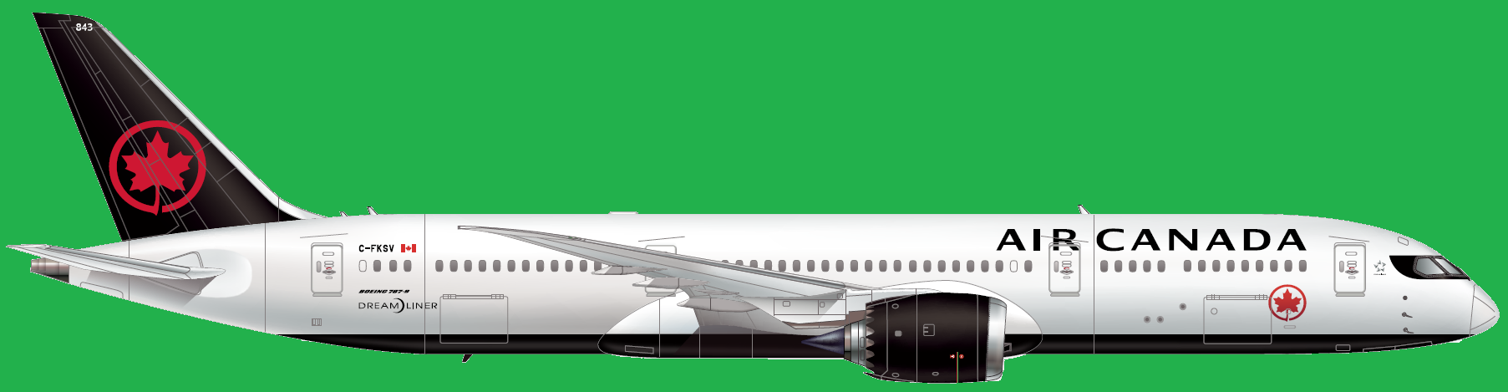
Thank you

